Slide 1
Requirements Specification
Monday, October 29st 2012

Slide 2
Welcome
Our Client:
Dr. Darren Lim
Professor of Computer Science
Siena College

Slide 3
Agenda
Introduction
Restatement of Problem
Project Progression
Use Case Diagram
Data Flow Diagram
Requirements Inventory
What is Next?
Use Case Narratives

Slide 4
Introduction
Christopher Small
Team Leader
Alyssa Nghiem
Web Master
Eduardo Pinto Barbosa
Document Analyst
Ryan Kennedy
Lead Developer
Tyler Vorpahl
Lead Graphic Designer

Slide 5
Agenda
Introduction
Restatement of Problem
Project Progression
Use Case Narratives
Use Case Diagram
Data Flow Diagram
Requirements Inventory
What is Next?

Slide 6
Restatement of Problem
Consortium for Computing Sciences in Colleges
North East (CCSCNE) Conference
Integrated System that handles…
Attendee Registration
Scholarly Works Submission
Scholarly Works Review
Information Access

Slide 7
Agenda
Introduction
Restatement of Problem
Project Progression
Use Case Narratives
Use Case Diagram
Data Flow Diagram
Requirements Inventory
What is Next?

Slide 8
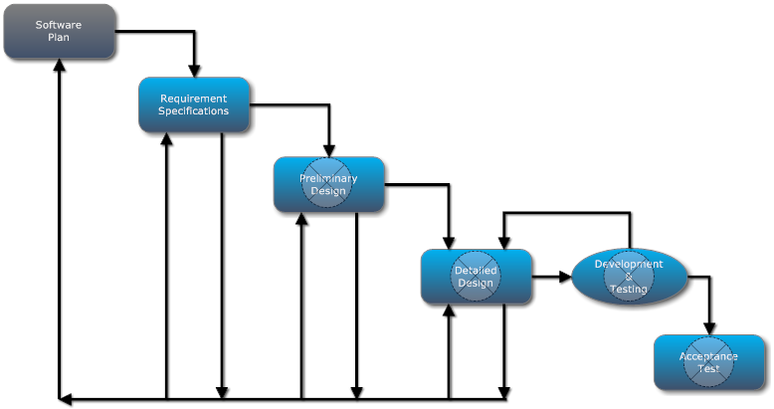
Project Progression

Slide 9
Agenda
Introduction
Restatement of Problem
Project Progression
Use Case Narratives
Use Case Diagram
Data Flow Diagram
Requirements Inventory
What is Next?

Slide 10
Use Case Narratives
Describes the capabilities of each user in detail
We will only show outlines here

Slide 11
Use Case Narrative: System Administrator
Logs in with a built-in account
Configures lists of conference chairs and submission chairs
Configures the questions users are asked during registration
Is able to view submissions and reviews

Slide 12
Use Case Narrative: Submission Chair
Confirms reviewers
Can view a list of submissions
Decides whether or not a paper should be accepted

Slide 13
Use Case Narrative: Reviewer
Submits credentials for approval
Views a list of works assigned for review
Submits a review for each assigned work

Slide 14
Use Case Narrative: Submitter
Uploads a scholarly work
Selects a topic for the work
Able to check whether the submission has been reviewed
Receives a notification via email of acceptance or rejection

Slide 15
Agenda
Introduction
Restatement of Problem
Project Progression
Use Case Narratives
Use Case Diagram
Data Flow Diagram
Requirements Inventory
What is Next?

Slide 16
Use Case Diagram
Shows actors that interact with the system
Shows which system features each actor interacts with

Slide 17
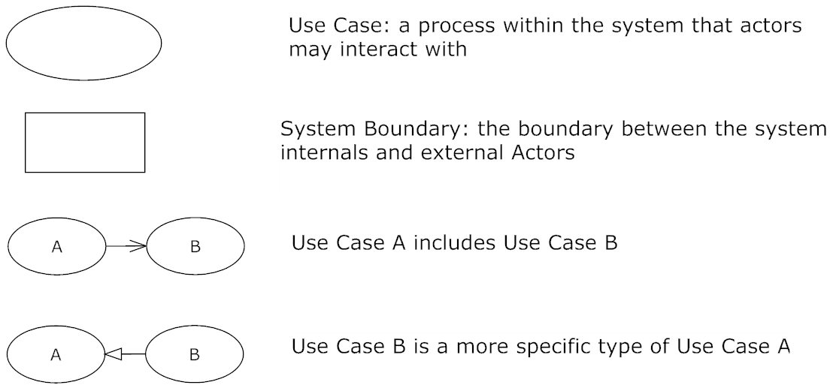
Use Case Diagram Legend

Slide 18
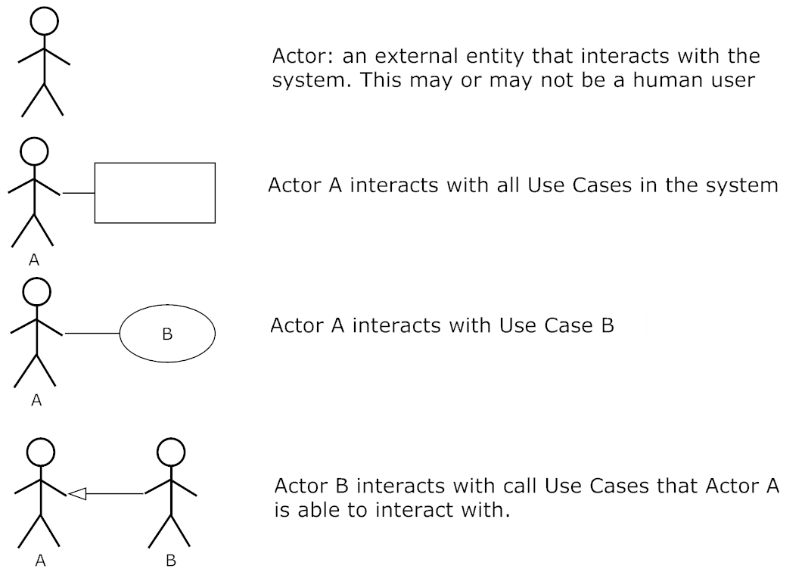
Use Case Diagram Legend

Slide 19
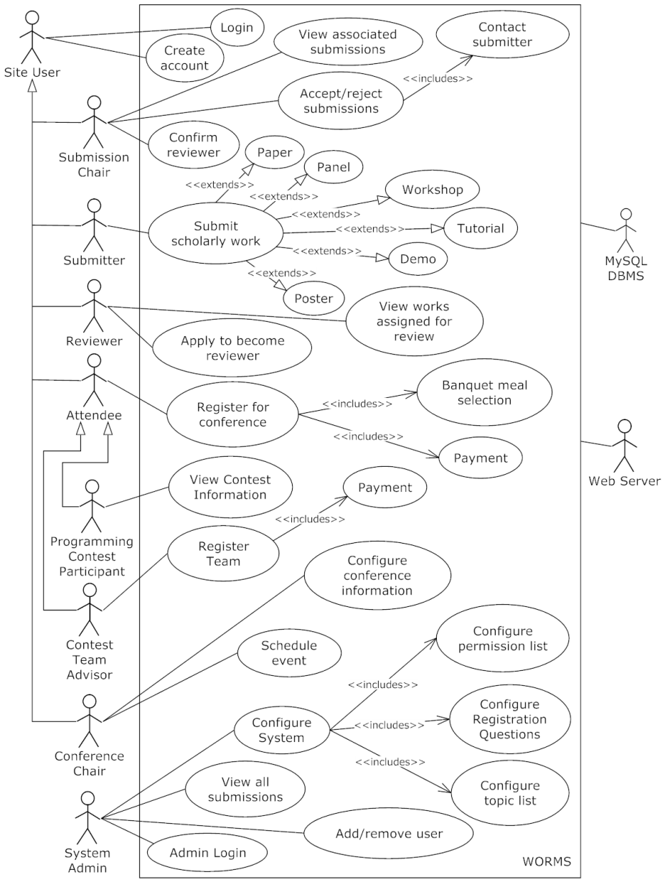
Full Use Case Diagram

Slide 20
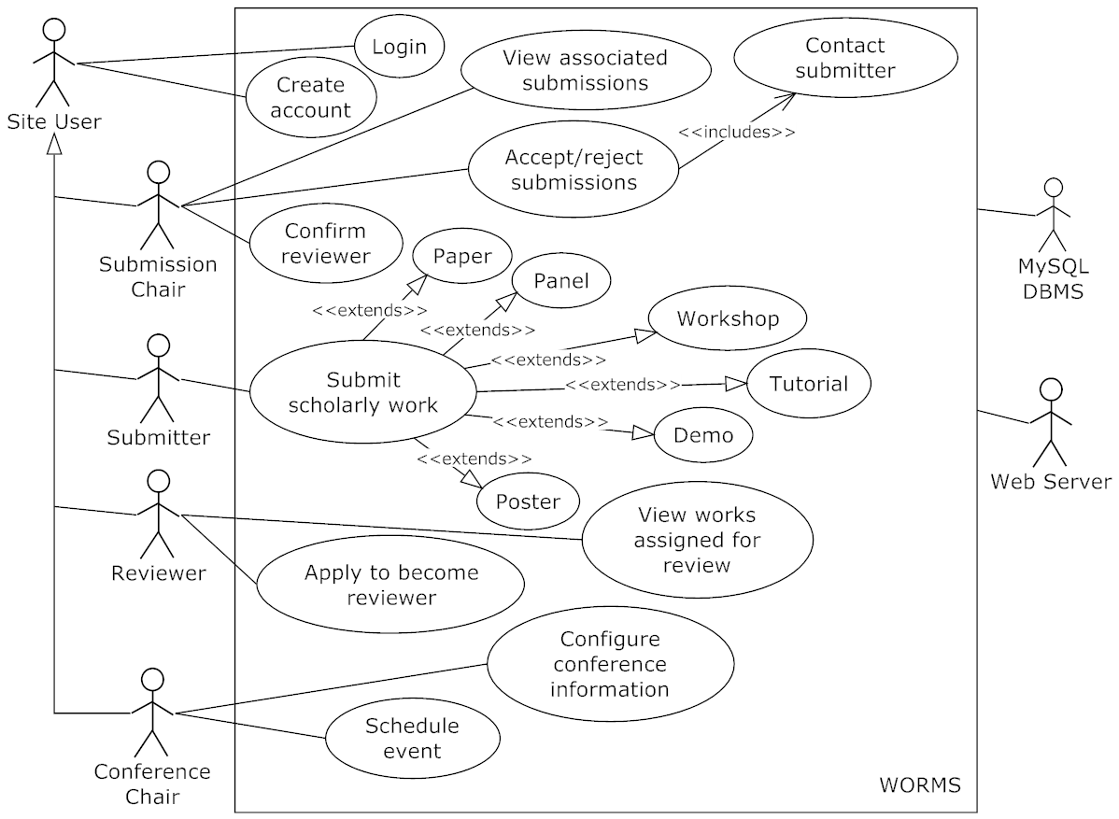
Use Case Diagram

Slide 21
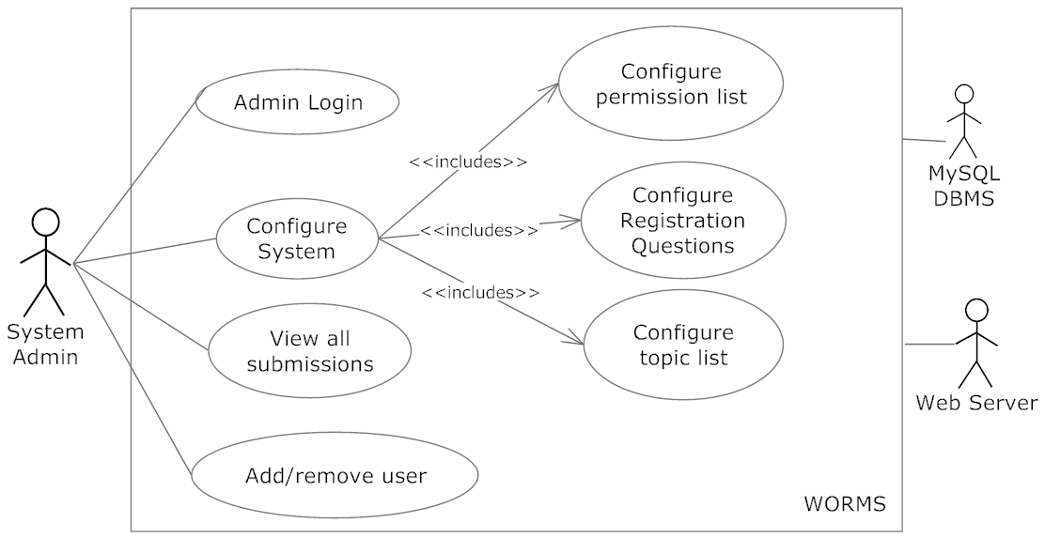
Use Case Diagram

Slide 22
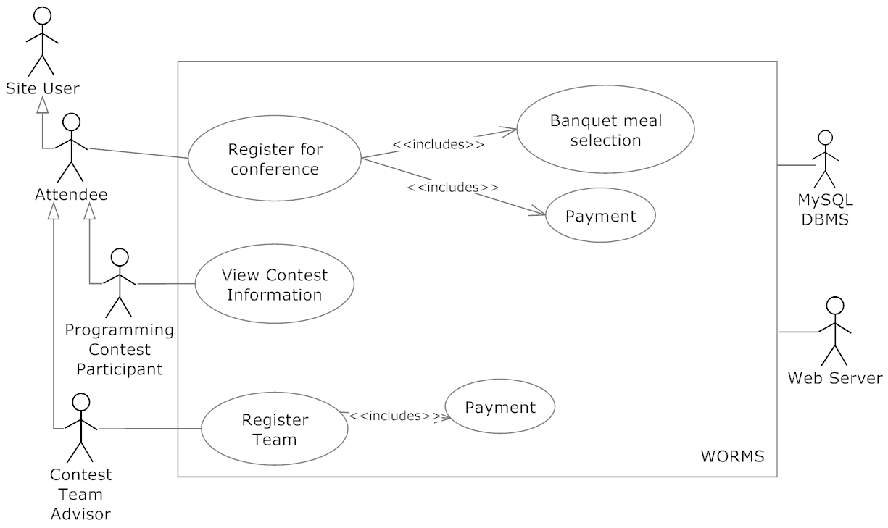
Use Case Diagram

Slide 23
Agenda
Introduction
Restatement of Problem
Project Progression
Use Case Narratives
Use Case Diagram
Data Flow Diagram
Requirements Inventory
What is Next?

Slide 24
Data Flow Diagram
Explains the movement of data between processes in the system and entities outside the system

Slide 25
Data Flow Diagram Legend

Slide 26
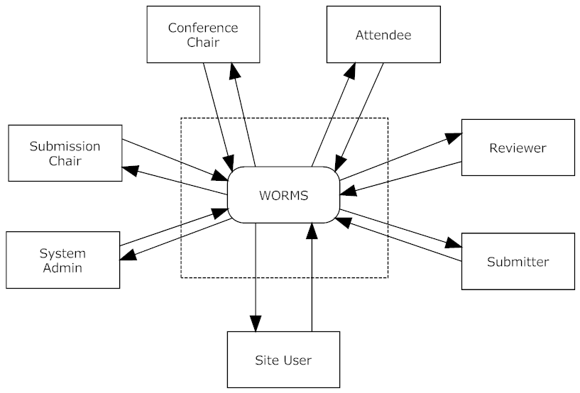
Context Diagram

Slide 27
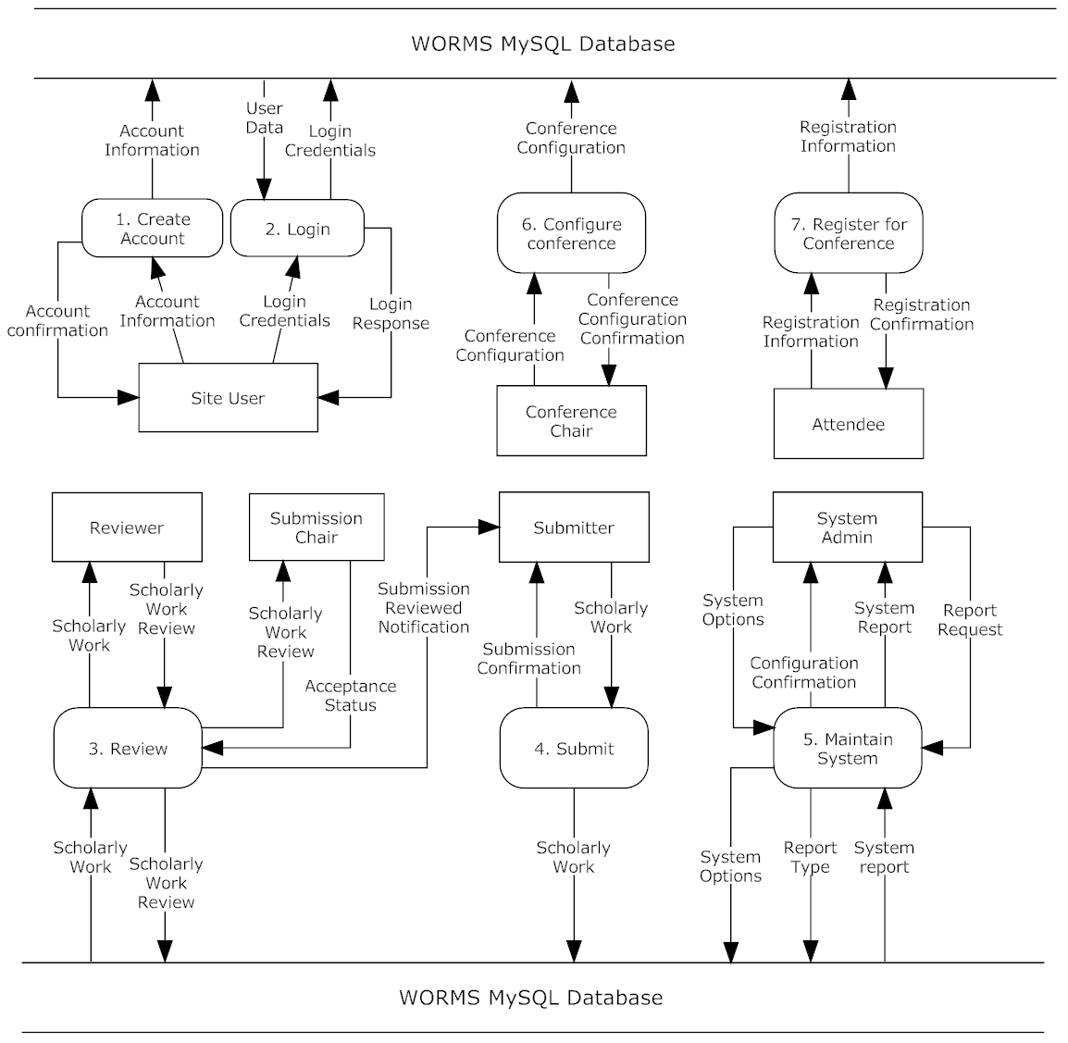
Level 0 Diagram

Slide 28
Level 0 Diagram - 1

Slide 29
Level 0 Diagram - 2

Slide 30
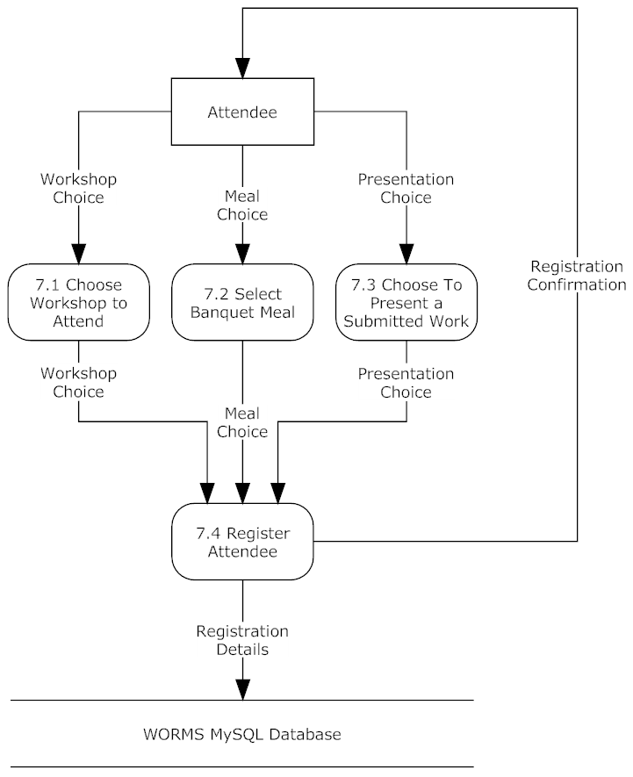
Process 7: Level 1 Register For Conference

Slide 31
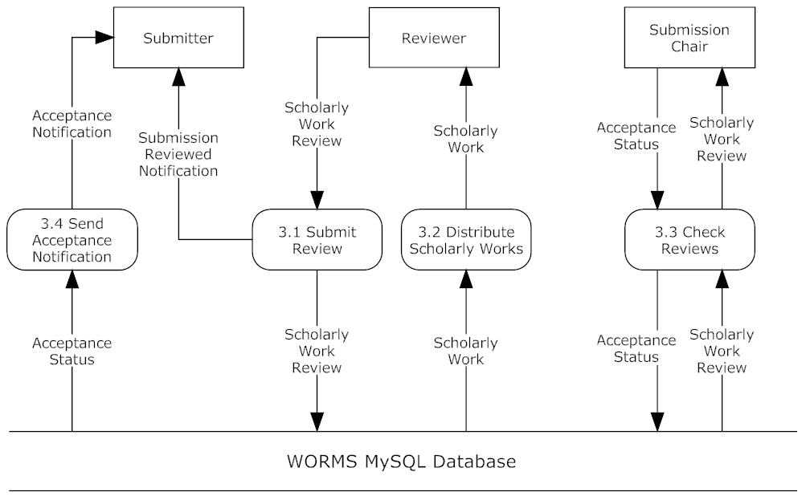
Review

Slide 32
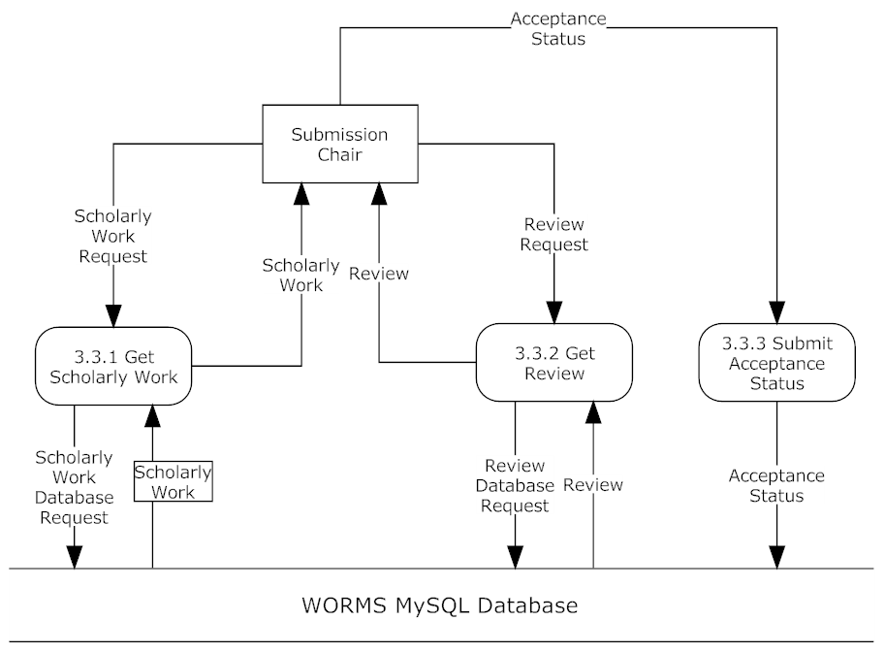
Check Reviews

Slide 33
Agenda
Introduction
Restatement of Problem
Project Progression
Use Case Narratives
Use Case Diagram
Data Flow Diagram
Requirements Inventory
What is Next?

Slide 34
Non-Functional Requirements
Easy to use
Easy to maintain
Works in all modern web browsers

Slide 35
Functional Requirements Inventory
System Administrator
Configure lists of email addresses of conference chairs and submission chairs to be stored in the database
View all content submitted by users

Slide 36
Functional Requirements Inventory
Conference Chair
Configure the conference schedule
Configure conference information
Hotels
Dates
Nearby Attractions
Meals

Slide 37
Functional Requirements Inventory
Submission Chair
Specifies submission deadlines
Views submitted works
Decides whether or not each work should be accepted

Slide 38
Functional Requirements Inventory
Reviewer
Submits credentials for approval
Views assigned works
Submit a review for each assigned work

Slide 39
Functional Requirements Inventory
Submitter
Uploads scholarly work as PDF
Selects a topic for the scholarly work
Receives an email notification of acceptance or rejection

Slide 40
Functional Requirements Inventory
Conference Attendee
Fills out conference registration form
Meal selection
Workshop selection

Slide 41
Agenda
Introduction
Restatement of Problem
Project Progression
Use Case Narratives
Use Case Diagram
Data Flow Diagram
Requirements Inventory
What is Next?

Slide 42
What is next?
Preliminary Design – December 10, 2012
Detailed Design – Spring 2013
Acceptance Test – Spring 2013

Slide 43
Questions?

